Slide 1


Topic: Plagiarism checker using basic python coding
TEAM NAME: ORACLE
TEAM MEMBERS: 22VE1A6735-SAIKIRANSAGAR.K
22VE1A6745-YASHWANTH REDDY.P
22VE1A6706-VAMSHI GOBIND.B

Slide 2
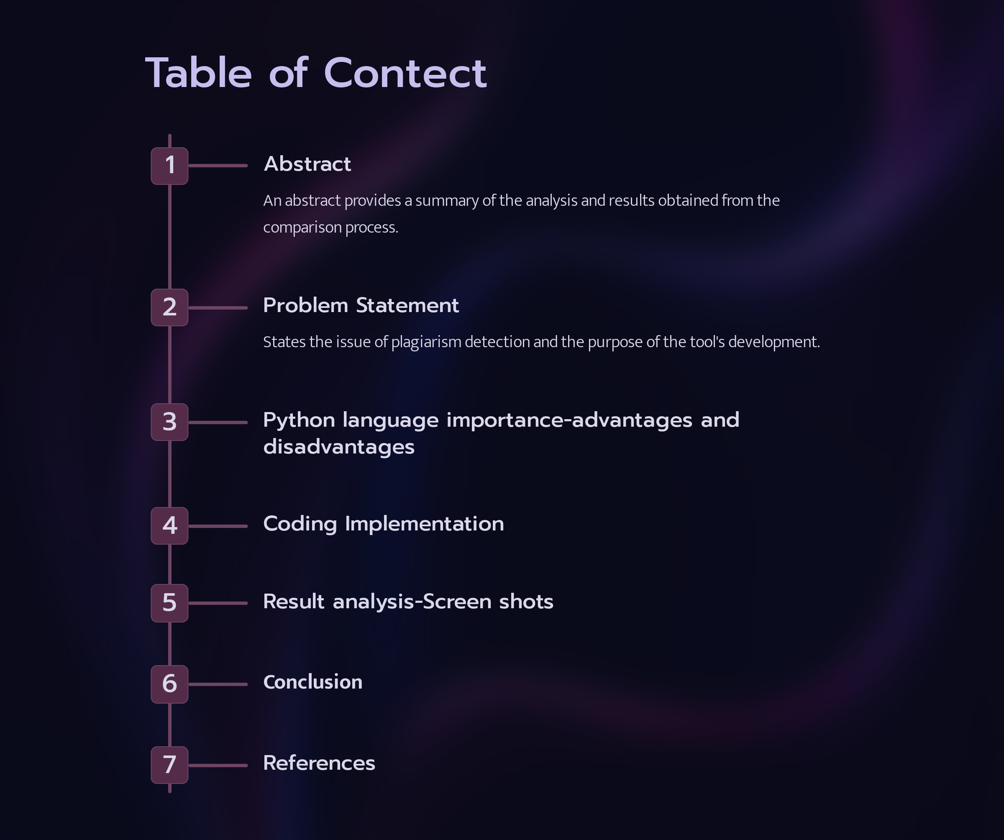

Slide 3
Abstract:
Python is a high-level, interpreted, and general-purpose dynamic programming language that emphasizes code readability. It is widely used in various organizations due to its support for multiple programming paradigms and automatic memory management. Python is known for its simplicity, extensive libraries, and active community, making it a popular choice for beginners and experienced programmers. However, it has some disadvantages, such as slower execution speed, less secure, and runtime errors due to its dynamically-typed nature. Additionally, Python's database access layers are underdeveloped, making it less often applied in huge enterprises. Overall, Python is a powerful and flexible language with advantages that outweigh its disadvantages, making it a valuable tool in the programming world

Slide 4
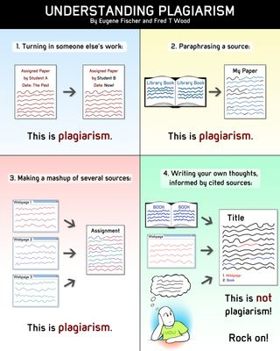
Plagiarism Checker:
Our tool is designed to identify potential plagiarism by comparing inputted text with existing sources. It aims to provide a reliable solution for detecting and preventing academic dishonesty.

Slide 5
Advantages:
1.Extensive libraries: Python has a rich set of libraries, including those for creating and manipulating PowerPoint presentations, such as python-pptx.
2.Easy to learn and use: Python has a simple syntax and is easy to learn, making it a good choice for both beginners and experienced programmers.
3.Cross-platform compatibility: Python can run on various operating systems, including Windows, Mac, and Linux, making it a versatile language for creating PowerPoint presentations.
4.Large community support: Python has a large and active community that can provide support and resources for creating PowerPoint presentations.
5.Open-source: Python is open-source, which means it is free to use and distribute, making it a cost-effective option for creating PowerPoint presentations.
Disadvantages:
1.Limited graphical capabilities: Python's graphical capabilities are not as advanced as other programming languages, which may limit its ability to create complex PowerPoint presentations.
2.Security concerns: Python is an interpreted language, which may pose security risks when creating PowerPoint presentations that contain sensitive information.
Limited built-in support for PowerPoint: Python does not have built-in support for PowerPoint, which means that programmers must rely on third-party libraries to create presentations.
3.Slower execution: Python is an interpreted language, which may result in slower execution times compared to compiled languages like C++ or Java.
4.Limited mobile compatibility: Python may not be the best choice for creating PowerPoint presentations on mobile devices, as it is primarily designed for desktop and server environments

Slide 6
from difflib import SequenceMatcher
import sys
def print_similar_words(text1, text2):
sequence_matcher = SequenceMatcher(None, text1.split(), text2.split())
matches = sequence_matcher.get_matching_blocks()
for match in matches:
a, b, length = match
words1 = text1.split()[a:a + length]
words2 = text2.split()[b:b + length]
print(f"Similar words: {words1}, {words2}")
def plagiarism_checker(text1, text2):
if text1.strip() and text2.strip():
text1 = text1.lower().split()
text2 = text2.lower().split()
sequence_matcher = SequenceMatcher(None, text1, text2)
print(sequence_matcher)
similarity_ratio = sequence_matcher.ratio()
return similarity_ratio
else:
return 0

Slide 7
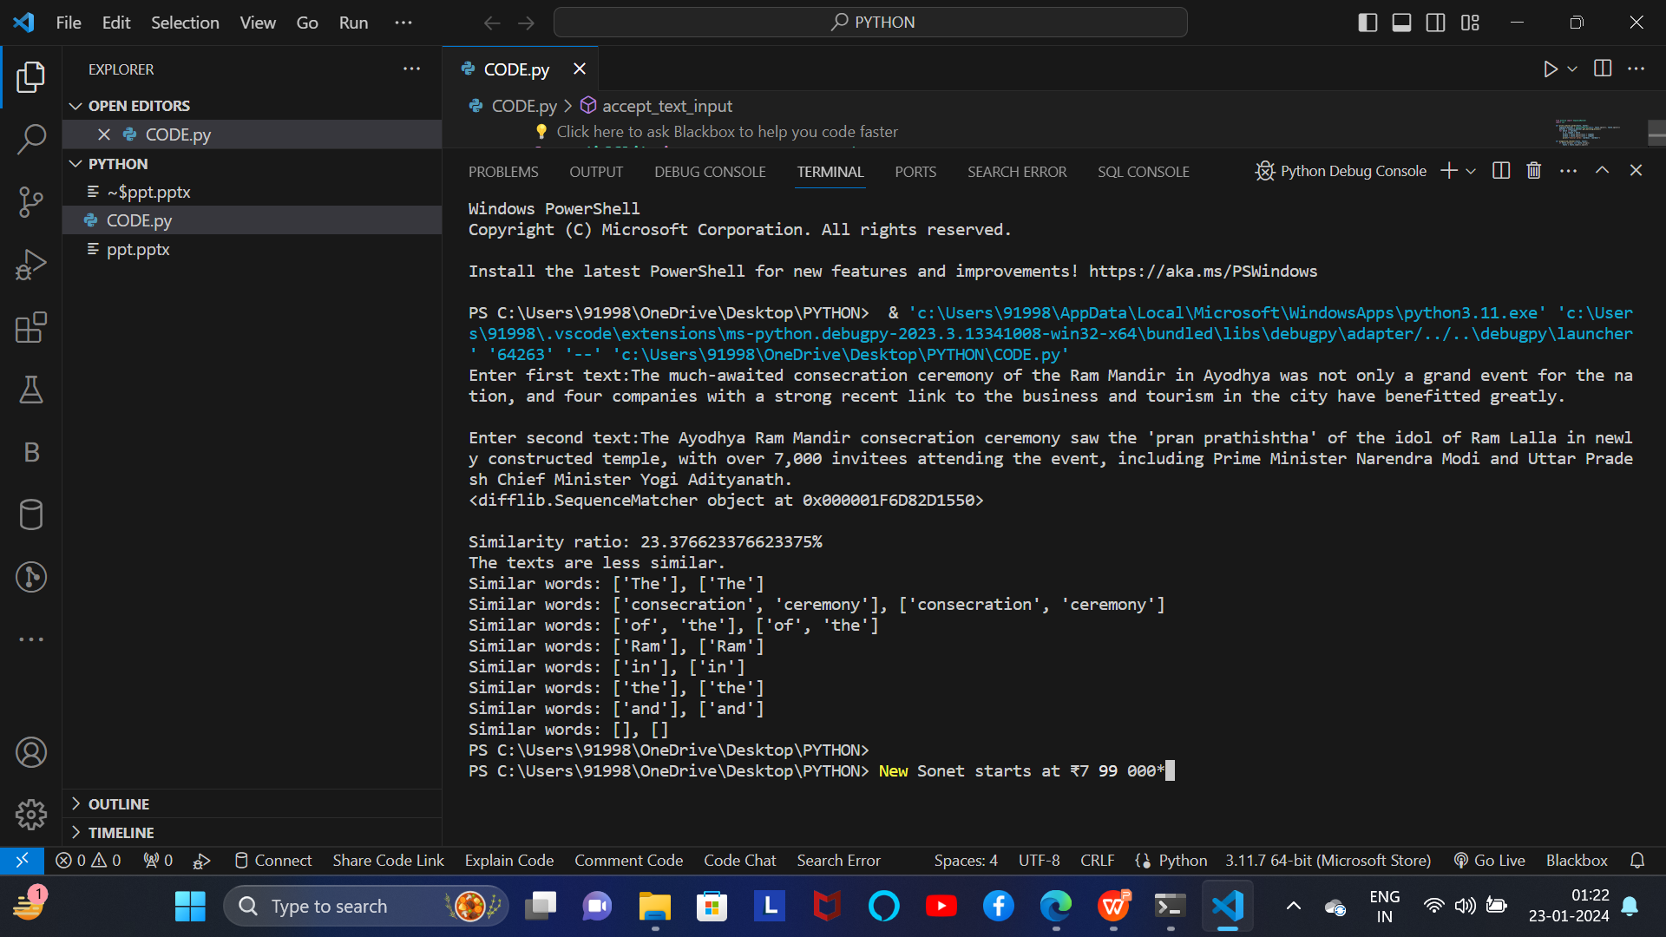
def accept_text_input():
print("Enter first text:")
text1 = input()
print("\nEnter second text:")
text2 = input()
return text1, text2
def main():
text1, text2 = accept_text_input()
similarity_ratio = plagiarism_checker(text1, text2)
average_length = (len(text1) + len(text2)) / 2
normalized_similarity_ratio = similarity_ratio / average_length
print(f"\nSimilarity ratio: {similarity_ratio * 100}%")
if normalized_similarity_ratio > 30.0:
print("The texts are very similar.")
print_similar_words(text1, text2)
else:
print("The texts are not similar.")
print_similar_words(text1, text2)
if "__name__" == "__main__":
main()

Slide 8
Conclusion:
Project's Goals and Achievements:
The project aimed to develop a robust tool for identifying potential plagiarism and has successfully achieved this objective.
Future of Plagiarism Detection
As technology advances and content generation increases, the future of plagiarism detection will continue to evolve, impacting academic and professional fields.

Slide 9
Future Work:
1.Improvements to Algorithm
Enhance the text comparison algorithms to provide more accurate and efficient detection of potential plagiarism.
2.User Interface Enhancements
Improve the tool's interface to enhance user experience and provide more intuitive input and result visualization.

